Slide 1



GLOW2.0 PROJECT TESTIMONIALS SUMMARY
Insights and feedback from project participants

Slide 2
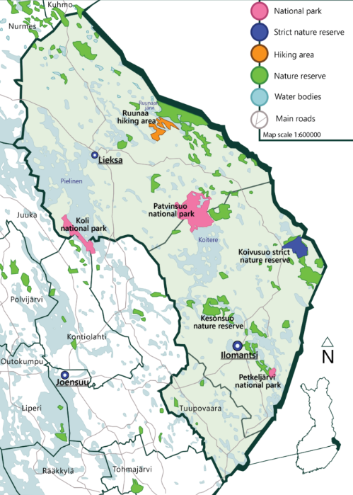
North Karelia Biosphere Reserve
(Eastern Finland)
North Karelia Biosphere Reserve is an UNESCO model area for sustainable development that seeks local solutions to global challenges in collaboration with the World Network of Biosphere Reserves. It aims at promoting solutions in own region that reconcile the conservation of nature with its sustainable use.
“Through the GLOW project, North Karelia Biosphere Reserve has been able to create new connections both within the region and abroad. The Biosphere Reserve’s staff understanding of Dark skies and tourism possibilities has improved and it will be easier to take the theme into consideration also in the future, and the project has created study materials that can be used also after the project in the North Karelia Biosphere Reserve’s networks.”
- North Karelia Biosphere Reserve Coordinator -

Slide 3
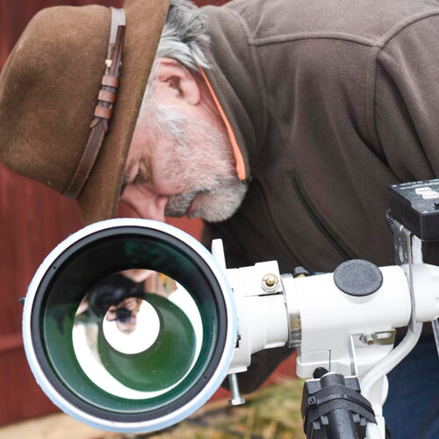
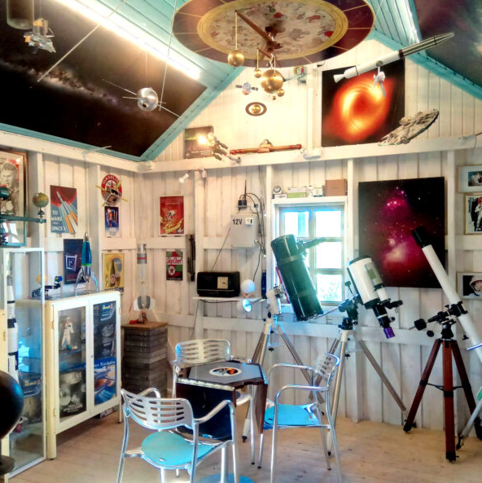
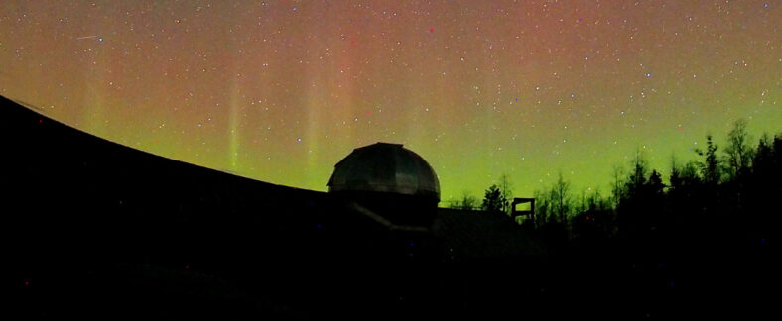
Syrjävaara Goodnight Oy
(Eastern Finland)
Syrjävaara Goodnight Oy is a 300-year-old and Finland’s first dark nature reserve offering night nature experiences. It featuring a star park, a dark sky center, an observatory, a gallery and a cafe.
“The GLOW2.0 project has been very useful. The visits and trips organized by the project have been broadening and have given a broader picture of the possibilities and stakeholders of dark sky tourism. Getting to know foreign actors has brought new international contacts. It has been particularly interesting to learn about the starting points of actors from different cultural areas and what kind of problems there are in their environment and operating culture.
GLOW2.0's help has been invaluable when the Syrjävaara Dark Sky Conservation Area has started applying for an international dark sky certificate with Dark Sky International. GLOW2.0 has helped with video meetings, translated large text units of the application, helped to clarify difficult terminology and commented on different parts of the application during the writing phase. Overall, GLOW2.0 has been very useful to Syrjävaara, and its help has often been invaluable.”
- CEO and owner at Syrjävaara -

Slide 4
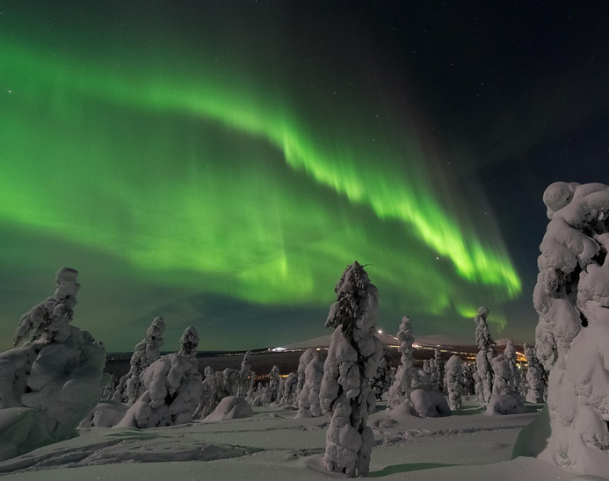
Arctic Stargazing Tours (Finnish Lapland)
Arctic Stargazing Tours provides tailor-made guided tours under the Night Sky for public groups and private events in the Finnish Lapland region.
“This program gave a concrete platform to develop both the ideas in how to develop the sustainable forms of the business and how to implement and market these to customers and co-operators and partners. Project activities such as taking part and providing workshops focusing on the artificial light and about its effects in business have been a measurable asset both financially and building a network of businesses to support the structure of sustainable travel in Finland. These were achieved by being able to access a network of other businesses that actively discuss and share their knowledge about the progress of becoming more sustainable as a business.”
- Founder of Arctic Stargazing Tours -

Slide 5
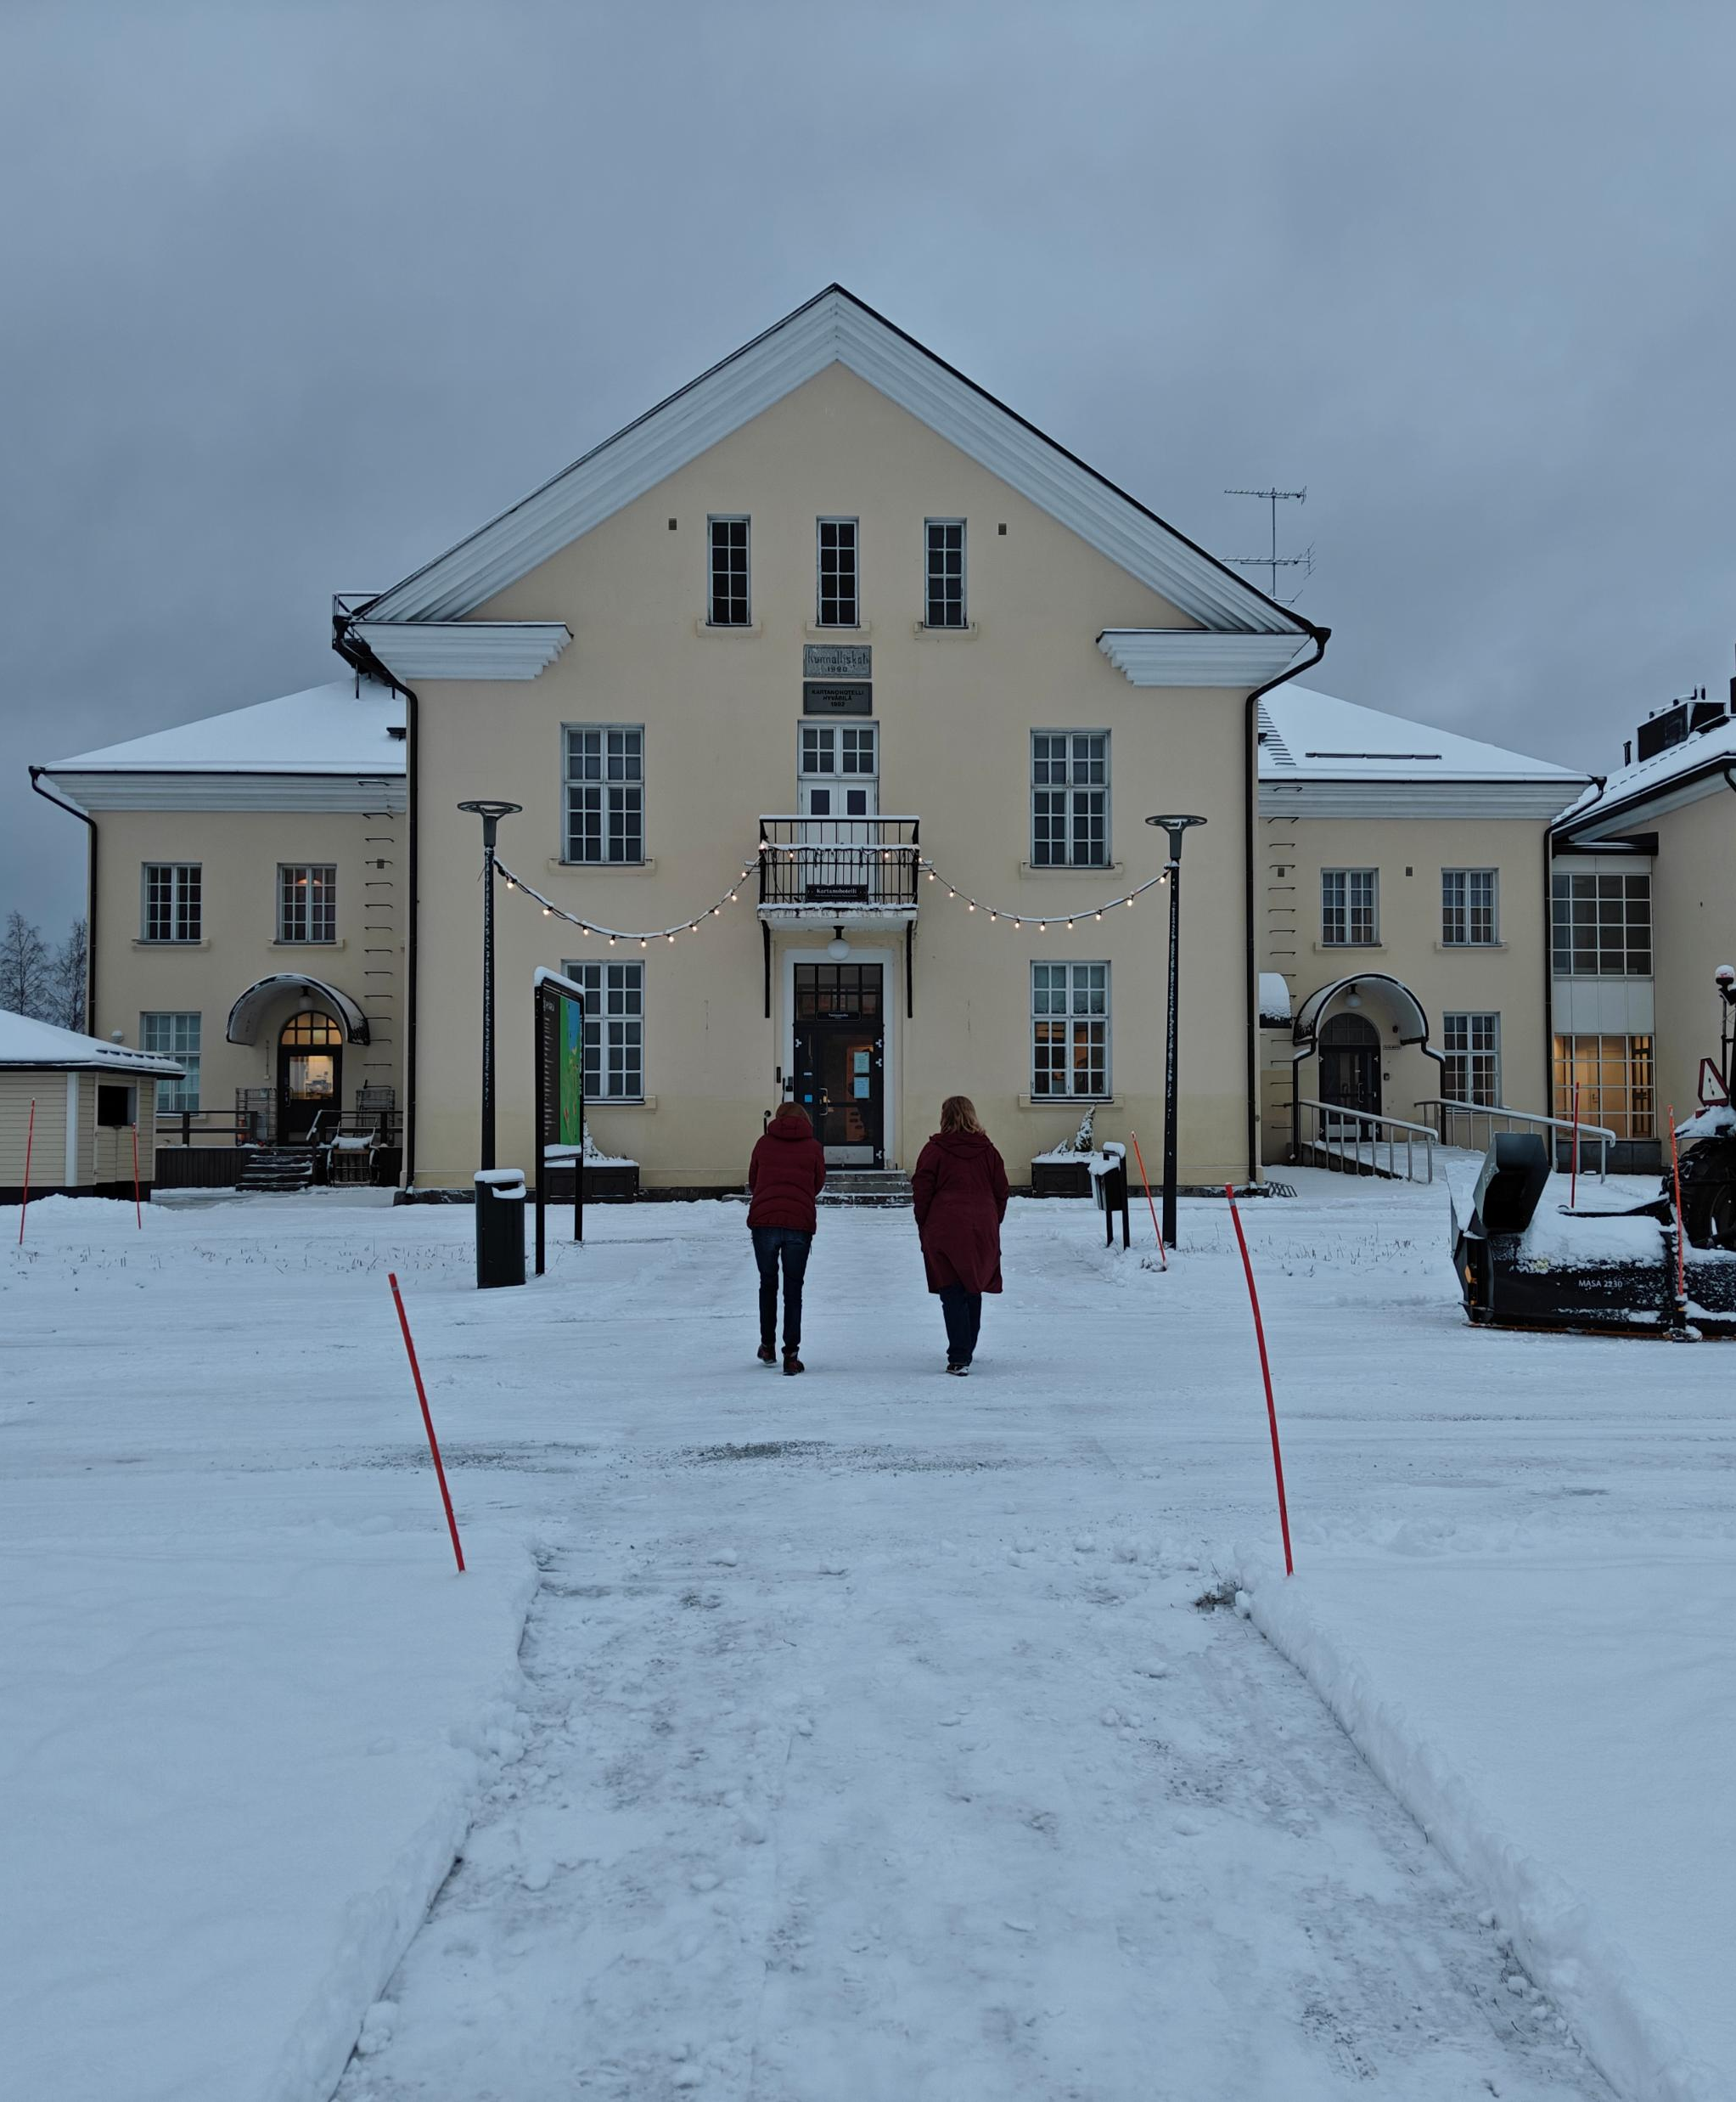
Hyvärilä Youth and Holiday Centre
(Eastern Finland)
Hyvärilä offers activities for young people and is also an excellent venue for a holiday, sports or different events.
“We participated in the project's training sessions in the winter and spring. We gained many new ideas on how to utilize darkness in our youth and other tourism services. We also learned about other companies that offer darkness experiences.”
- Youth manager at Hyvärilä -

Slide 6
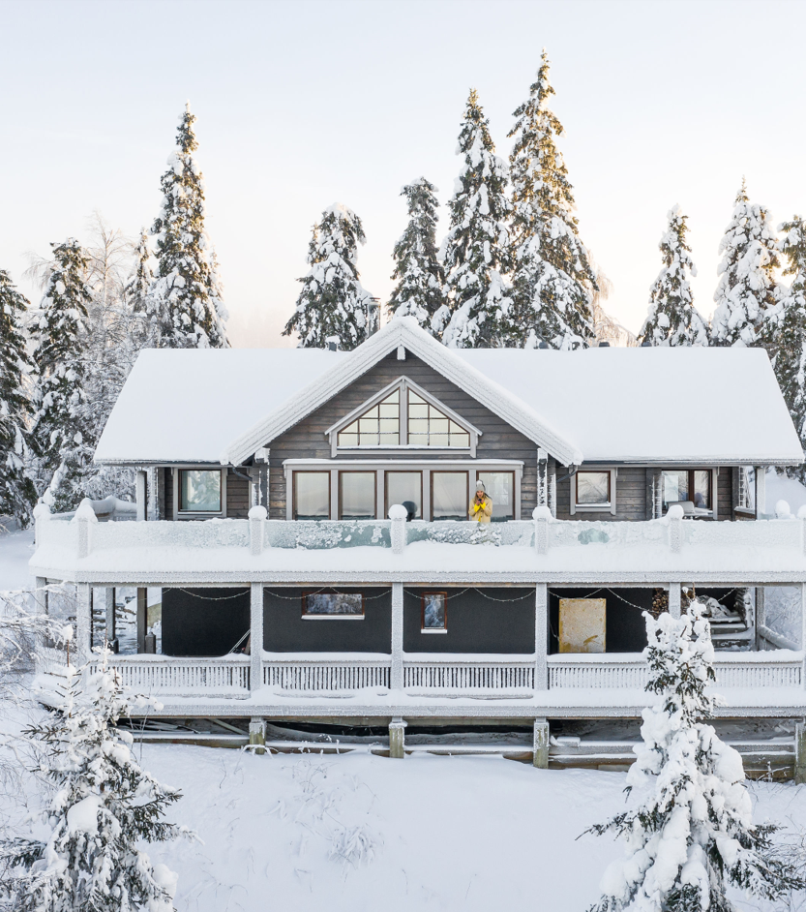
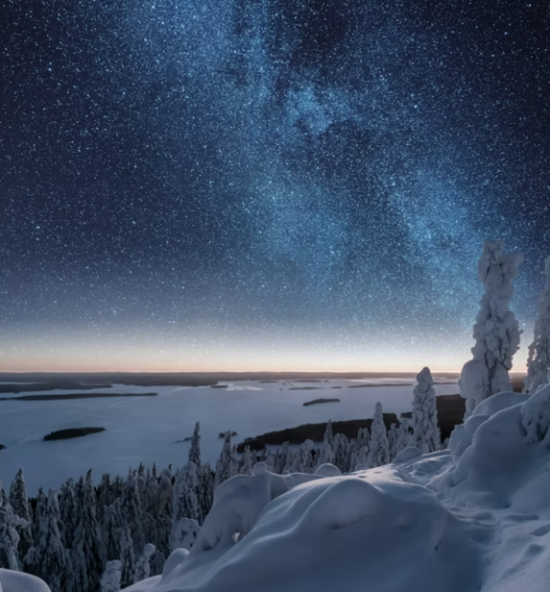

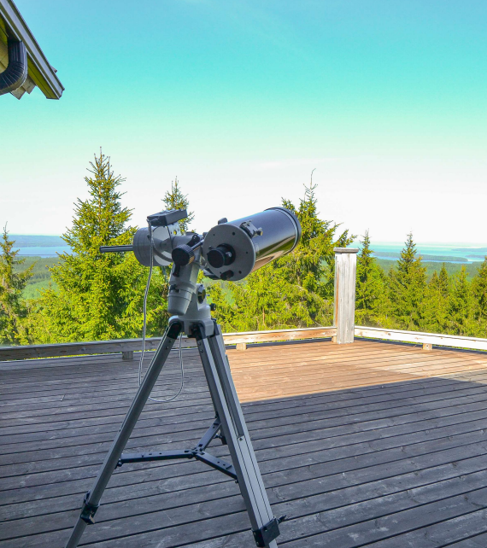
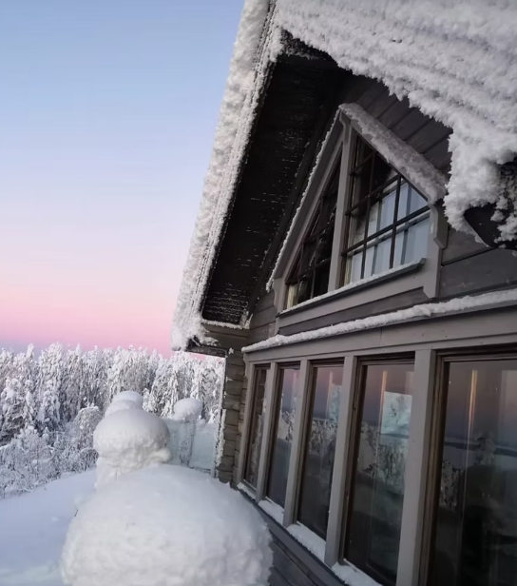
Kolin Kajo (Eastern Finland)
Koli Kajo is an accommodation facility close to Koli National Park, Finland’s National Landscape.
“Very positive experiences. The project presentations and discussions with the parties participating in the project brought us a lot of new information. We acquired a sky camera and telescope for our accommodation (Kolin Kajo) with Olli Reijonen/ Syrjävaara and took a lesson from Seulaset Ry (Ursa) on stargazing and using telescope. We created a product for our website with Seulaset Ry, but we have not yet managed to sell the offer. Only people/parties who are directed to our website can see the product.
As a result of the GLOW2.0 project, we were inspired to apply for the European LookUp project, and the lessons learned from it were also very useful. Stargazing and other nature trips are well-productized and publicly marketed tourism products in Central and Southern Europe - we were actually surprised by this. Now we would like to see related international marketing and cooperation with other program services in the region, a joint booking system could be a solution. Raising the awareness of all of Eastern Finland and its special features among international tourists would be of paramount importance! We are a partner in Kolin Matkailu Oy..”
- Owners of Kolin Kajo -

Slide 7
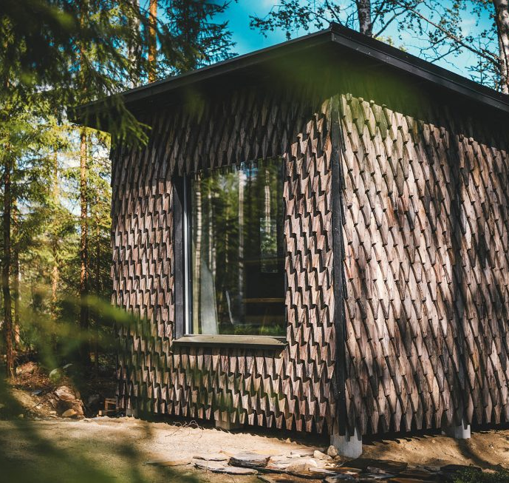
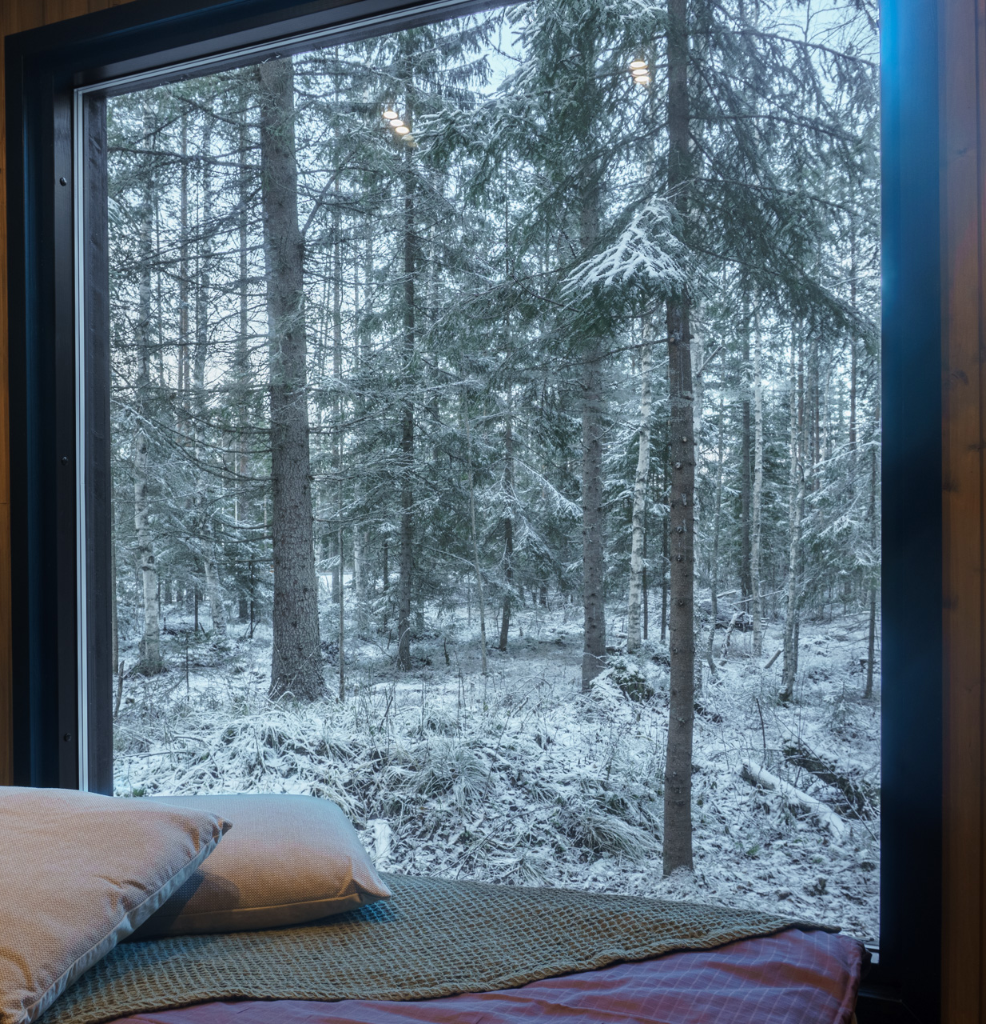
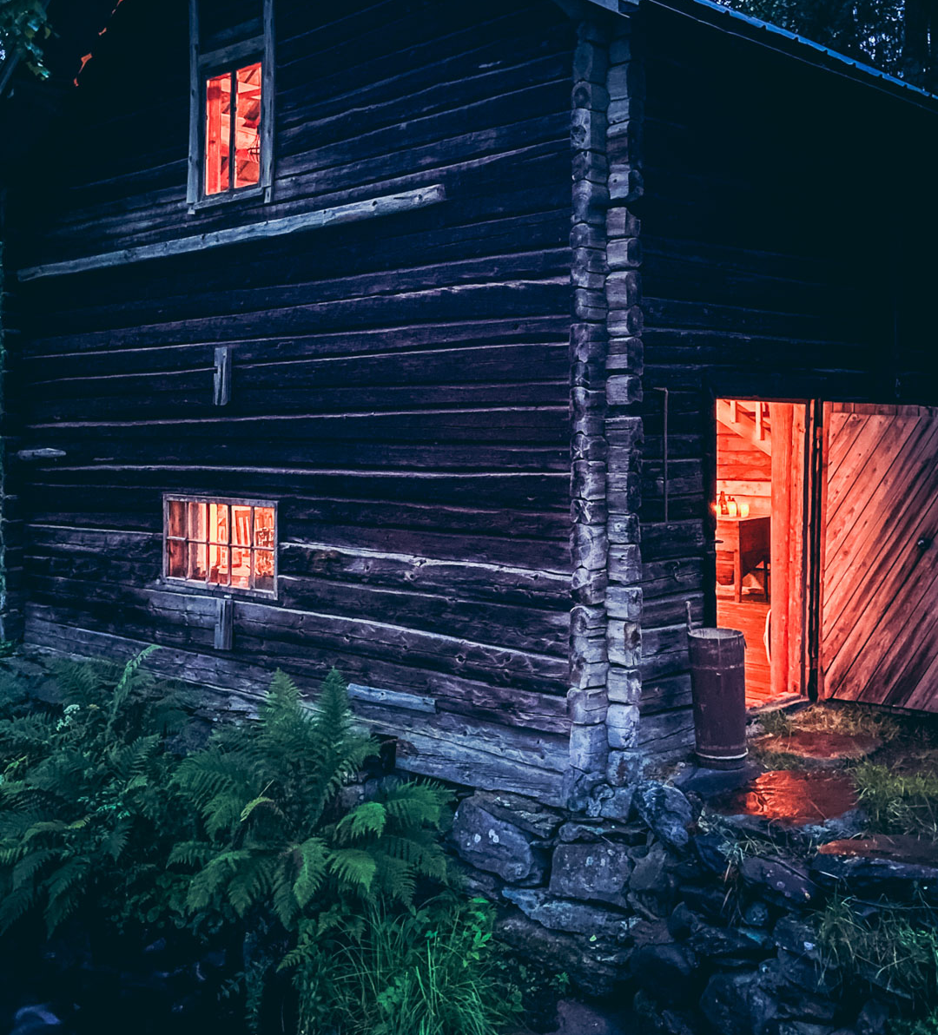
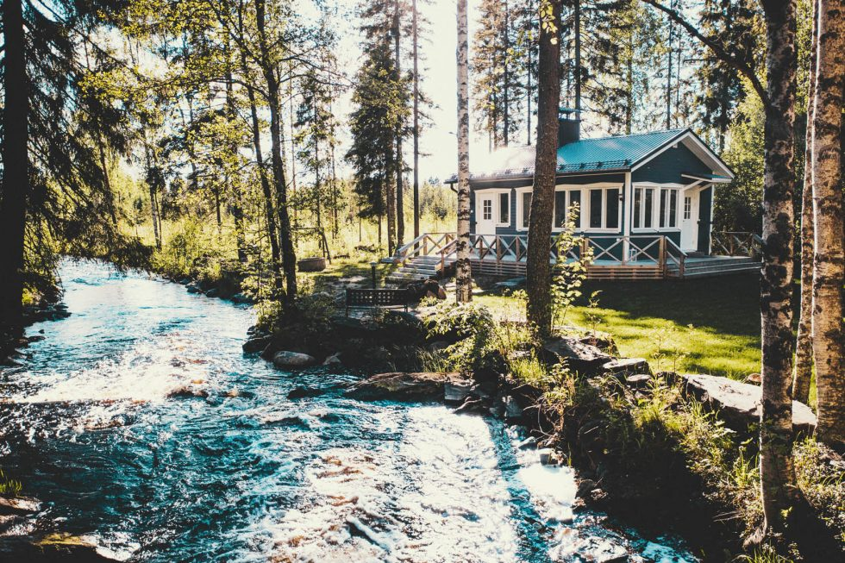
Venejoen Piilo (Eastern Finland)
Venejoen Piilo offers event services and variety of accommodation options.
“The Glow2.0 project gave us the opportunity to create a virtual version of Venejoki Mill, allowing visitors to explore the site's history across different time periods and natural phenomena, such as day and night scenes. The project brought us new expertise in digital presentation and provided a solution for sharing the story of the mill in an accessible and engaging way.
It has increased the visibility of the site and sparked new ideas for its future development..”
- Entrepreneur at Venejoen Piilo-

Slide 8
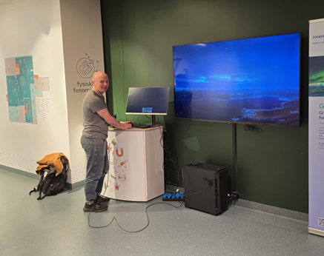
NORWAY
“We took part in a gathering through the GLOW 2.0 project, and we have tested VR experiences in our exhibitions. The project has given us new ideas for how we can use creative and digital tools to engage visitors in a fun and meaningful way.”
- Marketing manager at Vitensenter Nordland -
“The demonstrated immersive technology (Virtual Planetarium) holds potential, but I was not deeply impressed because the true strength of aurora-based experience lies in witnessing it in the real natural setting. I found the session on light pollution to be useful. It raised awareness on an issue I hadn't previously considered in depth, and it gave me a new perspective on how tourism activities should respect the natural darkness of our surroundings.”
- CEO at Fjellkysten -
“The VR experience is visually impressive and technically well executed, however we don't see relevance of the demonstrated immersive technology to our core offering. Even if we don't anticipate direct short- and long-term business impact from implementing the immersive technology ourselves, we remain open to promoting such experiences in collaboration with regional partners, if it adds value to our guests.”
- CEO at Quality Hotel Grand Royal -
“Through ongoing dialogue with local tourist operators and stakeholders, Visit Navik is encouraging the integration of Dark Sky elements into year-round offerings, particularly those aligned with northern lights tourism, immersive storytelling, and sustainable low-impact experiences. The ambition is to build on the momentum created through previous workshops and projects to gradually the niche in the Narvik region.”
- Project manager at Visit Narvik-

Slide 9
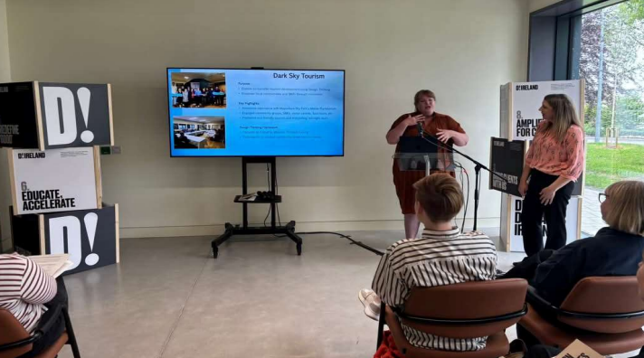
IRELAND
“Dark Skies Tourism was a completely new concept for us at Comhlacht Forbartha Inis Meáin, and we were grateful to be brought into the GLOW project by Martina and Údarás na Gaeltachta. Through GLOW, we had the opportunity to attend workshops, gain valuable insights, and learn from the experiences of other organisations actively promoting and protecting dark skies.
The support we received, including start-up kits, booklets, and other resources was incredibly helpful and played a key role in our learning journey. GLOW has been instrumental in building our capacity, and without it and Martina’s guidance we would not be in the position we are today. We now look forward to promoting Dark Skies Tourism independently and using it as a means to extend the tourism season on our island.”
- Representative of Comhlacht Forbartha Inis Meáin -
“Involvement with the project has been a very positive experience. The introduction to dark sky walks is a venture we hope to develop locally and also raise awareness regarding light pollution which is a very important step. With the stargazing kit we have received we hope to promote and develop this exciting project.”
- Geologist at Joyce Country and Western Lakes Geopark -

Slide 10
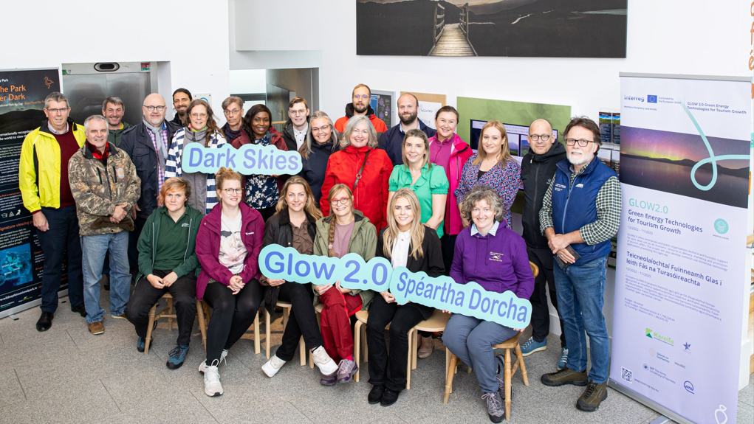
IRELAND
“Our experience has been very positive, very good to meet with people with same goals as ours. We are going for community dark sky status, we have had good turnouts at our events, working with schools and other business in the area and are raising awareness on light pollution.”
- Development officer at Lár Chomhairle Paróiste Ghleann Cholm Cille -
“We found the project very engaging and informative. Learning about the value of Dark Skies initiatives and how we can develop our own project to enhance our locality as a dark skies. The project has set on course to run our own dark skies events this coming Autumn.”
- Tourism officer at SOLAS -
“Involvement with the project has been a very positive experience. The introduction to dark sky walks is a venture we hope to develop locally and also raise awareness regarding light pollution which is a very important step. With the stargazing kit we have received we hope to promote and develop this exciting project.”
- Assistant manager at Comharchumann Mhic Dara -

Slide 11
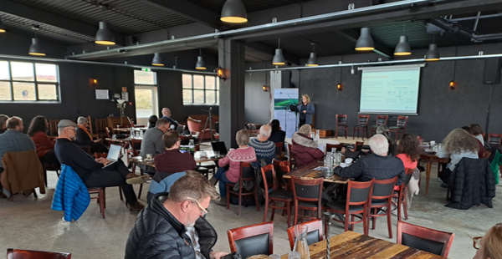
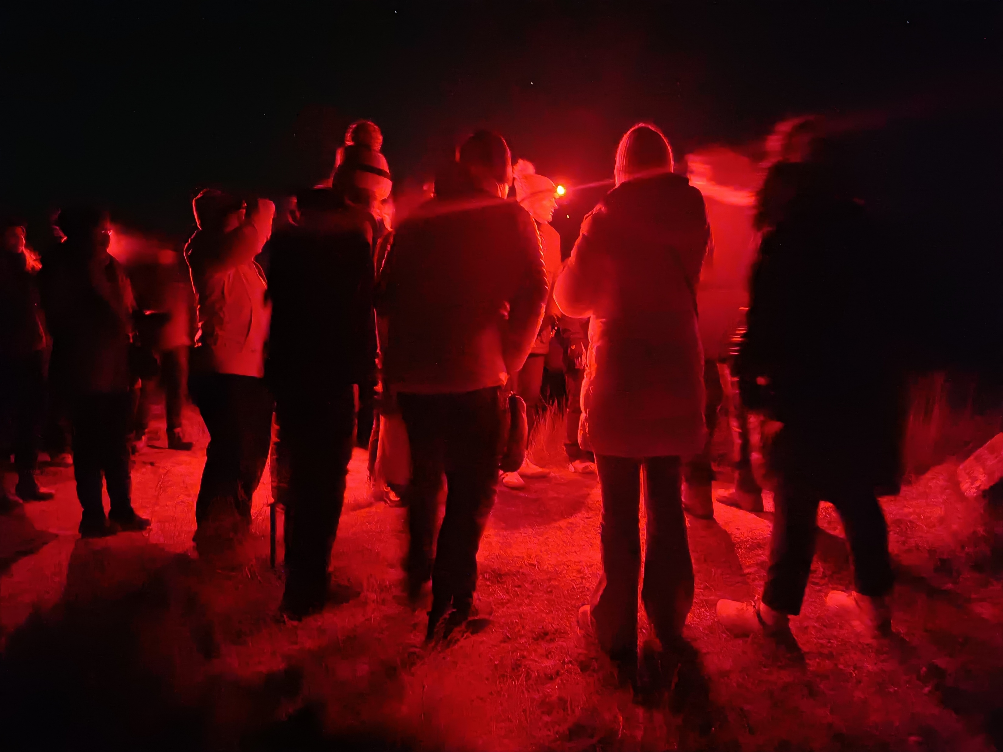
ICELAND
“We are running small guesthouse by the north coast of Iceland. We are located quite far from other houses and have noticed increasing interest in the Aurora and dark sky by our guests, since the conditions are very good. The project has given us many good ideas for making the experience even better for our guests i.e. designing the lights at the property and opening our eyes for more possibilities in low season.”
- Managers and owners of Gimbur Guesthouse -
“The project has had a positive impact on the experiential service to tourists during the darkest time of the year. The darkness with stars, northern lights, galaxies and good stories can create fond memories for the traveler. It is not just the northern lights; everything else matters too. Even a blanket and a cup of hot chocolate can create a wonderful experience. It's interesting how you can illuminate places with less light than usual and make them even more beautiful.”
- Assistant manager at Hótel Blönduos -
“Discovered many more possibilities to introduce people to the darkness and the nights in the Island.”
- Owner of Listakot Dóru-

Slide 12
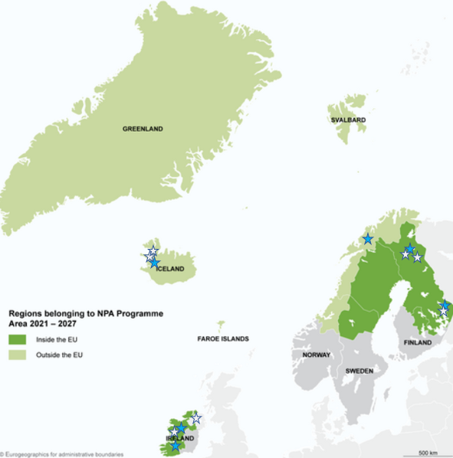






Partners
Associated partners
Project webpage:
https://www.interreg-npa.eu/projects/glow20/

