Slide 1
Sustainable SMEs workshop conclusions
Tools for sustainability reporting
2026-03-26
BioFuel Region

Slide 2
Workshop facts
Target
The workshop aims to highlight different reasons for sustainability reporting and to get both a quick overview of available tools and a chance for a more in-depth look at one of the tools presented. Target groups are SMEs (particularly manufacturing, bioeconomy and supply-chain exposed businesses), SME support organisations, and sustainability, innovation and digitalisation practitioners.
The information gathered is used to plan the upcoming pilots, guidebook content and other project activities.
Participant groups in the workshop
SME (15)
Business developer (5)
Regional developer (16)
Reporting expert (8)
Researcher (5)
Other (6)
Agenda 23.3.2026 at 13:00-14:30 CET
13.00 - 13.15: Reasons why and advantages of sustainability reporting. Real world examples from different companies and the reasons for reporting. Martin Svensson, BioFuel Region
13.15 - 13.25: Do you need tools for sustainability reporting? Ellinor Axelsson, Parilo
13.25 - 14.00: Short pitch sessions from tool suppliers
VSME training, Nelly Kortesniemi, Lapland UAS
VSME Digital Template, Mathias Mingazzini, EFRAG
Strimple, Per Berggren, Strimple
ARC, Ciara Greaney, White Spire
ESG-tool, Vilma Saari, DIMECC
Planmark, Mikko Hentunen, Planmark
Morescope, Marcus Aicardi, Position Green
14.00 - 14.30: A deeper look into one tool - breakout sessions. A more comprehensive presentation on the different tools presented during the pitching session. Participants choose which tool they want to take a closer look at.

Slide 3
Workshop conclusions: findings
Benefits of sustainability reporting (Why and for whom?)
Gives credibility and competitive advantages
Help identify business risks
Improves customer, finance and issuers relations
Support management, decision-making and reporting
Findings from pitching of different tools
VSME training: ”Low effort, low cost, High value” Developed in an EU program tested on 96 companies. Free of charge
VSME Digital Template: Developed by EFRAG, Interactive excel sheet that provide guidance and a starting point to the market. Combines with XBRL taxonomy & XBRL Converter. Used by + 100+ SME’s. Free of Charge open source
Strimple: Developed to help SME’s 2-150 employees. Step-by-step Guidance, covers ESG, Generate complete report. Cost: 700 €/ report
ARC - Activity reporting for carbon: Ingest economical and financial data and classify and grade them by GHG scope and supply chain country. Results in Auditable dataset for scope 1-3. Cost: 1500-2000 €/yr
ESG-tool: Web based platform designed for SMEs. Acts as a data bank and assessment help to help with administrative burden. Free of charge
Planmark: A modular ESG intelligence tool. Turns PDF’s and spreadsheets in to audit-ready VSME disclosures. Ensures automatic compliance, zero data chaos, strategic impact and rapid ROI. Designed for SMEs Cost: 2400 €/yr
Morescope: A modular AI powered tool for carbon accounting. Uses existing data and integration and give insights into action by targeting the most impactful decarbonization levers. Cost: 10 000-20 000 €/yr
Are tools needed for sustainability reporting?
NO
If you have time and skills to understand and explain the standards for your colleagues and are used to collect data from internal and external sources.
If you prefer to outsource and have uncertainties about next year’s scope and reporting.
YES
If you want a ready-made structure with concrete actionable steps and need help to manage and collect data.
If you want to have full control and have a well-defined sustainability strategy

Slide 4
Workshop conclusions: continuation
From the questionnaire
75% of the participants found the workop useful or very useful.
Most found the workshop through/via email and personal contacts
Comment: Thank you for presenting a good overview on whether the tools are needed, and what kind of tools there are available for SME's.
Which topic would you like to know more about
How to get started, what are my KPIs - the most relevant actions.
Sharing of best practices related to sustainability.
Use of data, AI, and automation to improve efficiency.
Solutions for Scope 3 emission calculations for SMEs.
Sector specific reporting, e.g. forestry sector.

Slide 5
SUSTAINABLE SMEs
enhances SMEs’ understanding about the reporting and the sustainability transition as a whole
NPA project NPA0800241
Length 4/25-3/28
Funding about 1,5 M€
Coordinated by Jamk University of Applied Sciences
Partnership covers Sweden, Ireland, Iceland, Norway, and Finland
Notes:
Why SMEs need to know about sustainability reporting?
Project id (automatically created) NPA0800241
Name of the lead partner organisation Jyväskylän ammattikorkeakoulu Oy
Name of the lead partner organisation in
English
Jamk University of Applied Sciences
Project title Sustainability reporting enhancing SMEs' market
reach, competitiveness, and sustainable growth
Project acronym Sustainable SMEs
Programme priority Strengthening the innovation capacity for resilient
and attractive NPA communities
Specific objective 1.3: Enhancing sustainable growth and
competitiveness of SMEs and job creation in SMEs,
including by productive investments
Project duration in months 36

Slide 6
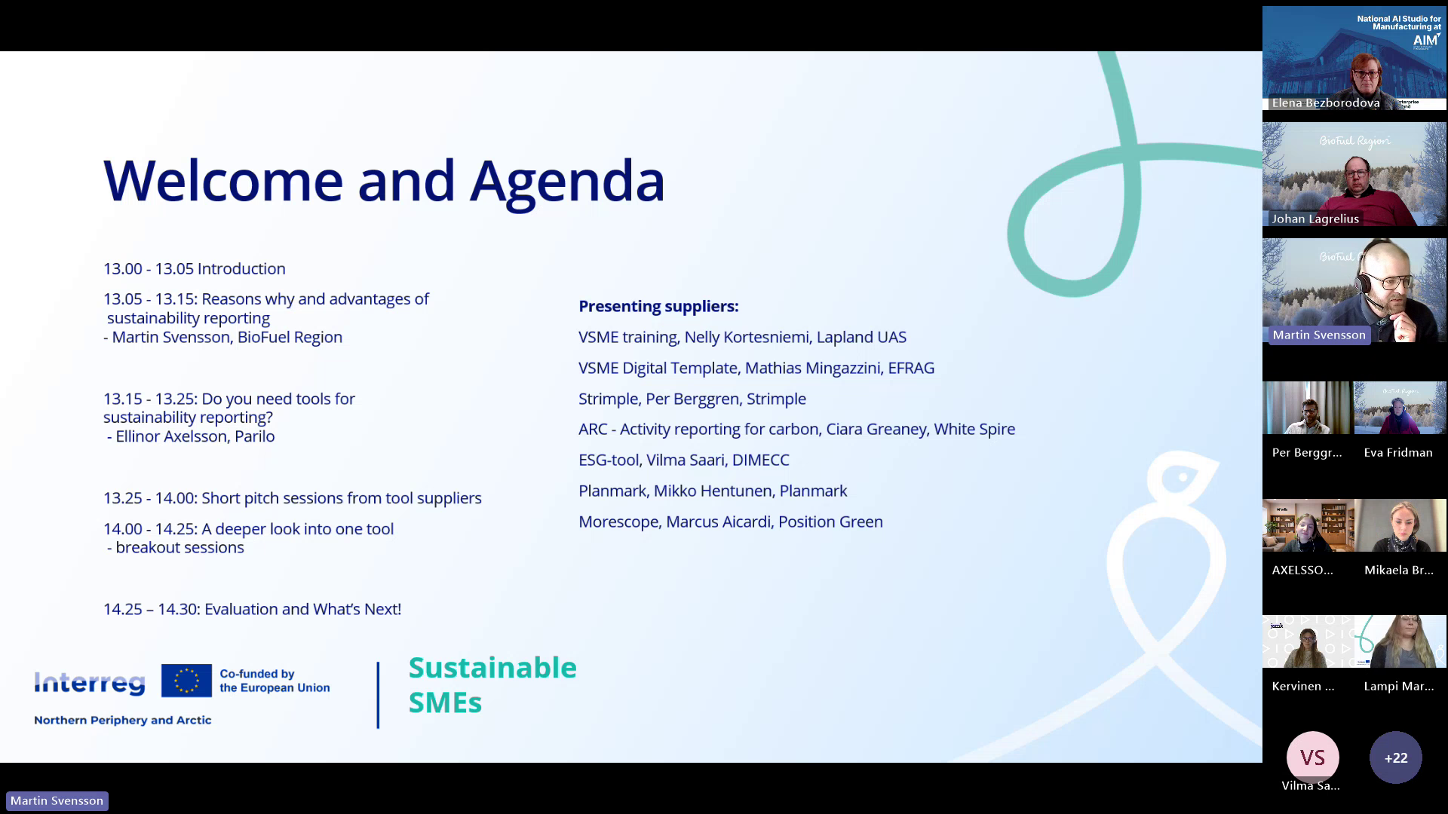

Slide 7
Thank you!
https://www.interreg-npa.eu/projects/sustainable-smes/

